Slide 1

Mobile programming

Slide 2

Introduction
Basic definitions:
An application:
An application is a software that lets you exchange information with customers and help them complete specific tasks.
A mobile App
A mobile app (or mobile application) is a software application developed specifically for use on a small, wireless computing devices

Slide 3

Major types of mobile apps
Native app
A native app, or native application, is a software application built in a specific programming language, for the specific device platform, such as iOS (iPhone) or Android.
Hybrid apps
A hybrid app is an app that combines web and mobile technologies, to be able to run in a variety of environments with largely the same code base.
Progressive Web Apps
A Progressive Web App (PWA) is a type of web application that leverages modern web technologies to deliver an app-like experience to users

Slide 4
Comparing the various types of mobile applications
Performance
User Experience
Platform Compability
Offline functionalities

Slide 5
Comparing the various types of mobile applications
Access to offline features
Discovery
Development time
Updates

Slide 6
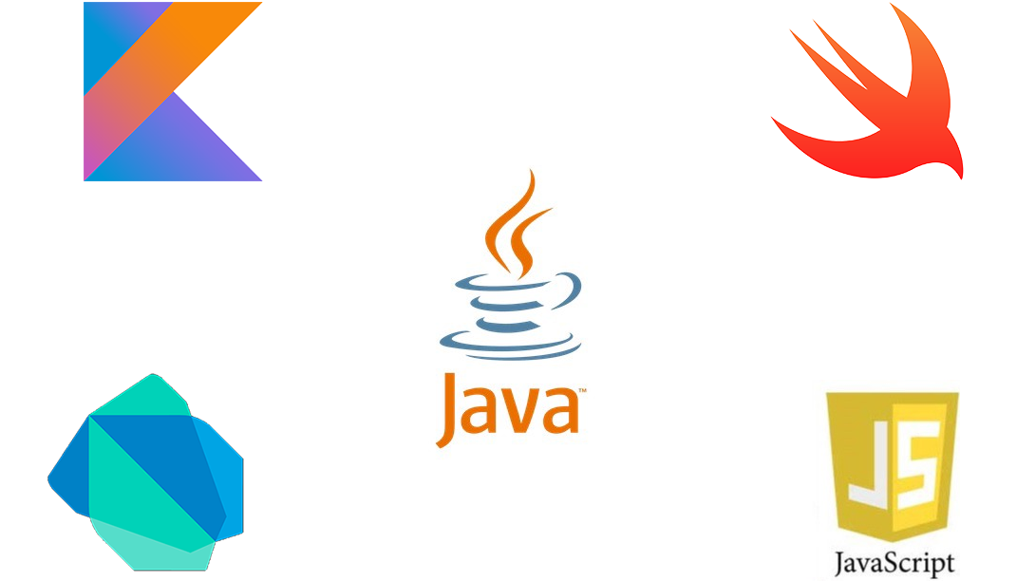
Mobile App Programming Languages
Javascript: JavaScript is among the most popular mobile app development languages, leading the list that allows one to develop exceptional mobile applications. With highly flexibility and adaptability, it holds support with environments other than browsers.
Kotlin: Kotlin is a language for mobile app development sweeping the Android app development industry. With its conciseness and expressiveness, it has gained great popularity among developers.
Swift: Swift is convenient for iOS developers to create feature rich iOS applications.

Slide 7
Mobile App Programming Languages
C#:
Dart: Dart is also one of those mobile programming languages that eases the cross-platform development journey. It is specifically designed keeping clients in mind.
Java: The most widely used programming language for developing high-end applications is Java. Known for its power and security in the mobile application industry.
HTML5: HTML5 is the most recent evolution of HTML and the most popular markup language. In this way, online content can be organized and presented more effectively.

Slide 8

Knowing the various types of Mobile App frameworks
React-native:
Flutter
Xamarian
Kotlic
Ionic

Slide 9

Comparing the different mobile App frameworks
Comparing criteria depends on;
Performance
Language
Cost and time to market
UI and UX
Complexity
Community support

Slide 10

Mobile App architecture
Definition
Mobile application architectures and design patterns are fundamental concepts for building well-structured, maintainable, and scalable mobile apps
Types of Mobile App architecture
Monolitic
Layered
Microservices
Model-view controller
Model-view-Viewmodel

Slide 11

Design Patterns In mobile app
Various types if design patterns
Singleton
Factory
Observer
Adapter
Decorator
Repository
Dependency Injection

Slide 12

Collecting and analyzing User Requirements for a mobile App
Various types of requirements for mobile apps
Business requirements
User Requirements
System Requirements

Slide 13
Steps to gather requirements for a mobile app
Step 1: Define your app idea and purpose
What purpose will the mobile app serve?
Does it offer a solution to a potential problem?
Step 2: Gather and align the app and business objective goals
Gathering business requirements to document
Techniques used to gather stakeholder requirements for the business requirement
Step 2: Gather and align the app and business objective goals
Gathering business requirements to document
Techniques used to gather stakeholder requirements for the business requirement

Slide 14

Steps to gather requirements for a mobile app
Step 3: Run a market analysis and competitor analysis
process of gathering user and competitor requirements
Step 4: Determine scenarios and a user Personal
Step 5: Gather and priorities functional and non-functional requirements.
Step 6: Design use cases and user stories
Step 6: Design Use Cases And User stories
How to Design a UStep 5: Gather and priorities functional and non-functional requirements.

Slide 15
Steps to gather requirements for a mobile app
Step 7: Write an app requirement document
Deploy prototyping and wireframing
Validate the app requirements

Slide 16

Estimating cost for developing a mobile App
Estimating the cost of mobile app development can be tricky as it depends on several factors.
Features and Complexity
App Platform
Development Team
UI/UX Design
Backend Development

